Slide 1
British Airway Predictive Analysis

Slide 2
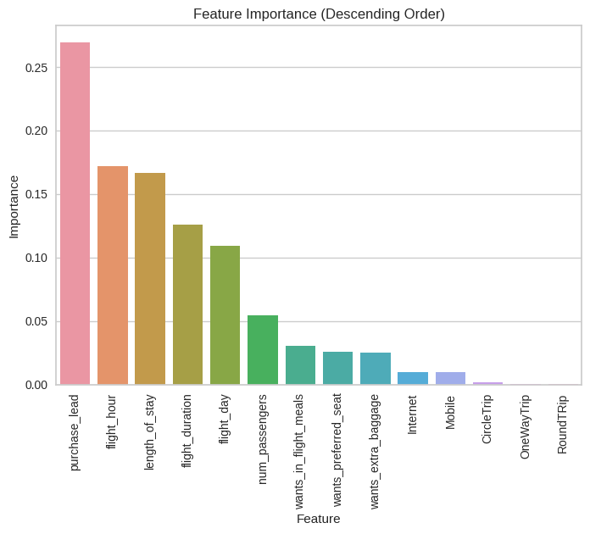
Predictive Findings
score
87%
R2 score
5%
Mean absolute error
44%
Algorithm | Score
Random Forest Regressor | 0.86
Logistic Regression | 0.59
Linear Regression | 0.048
Decision Tree Regressor | 0.99, -0.71(r2 score)
Random Forest Regressor skf modelling | 0.87
Logistic Regression skf modelling | 0.60
The most important variable in the model was purchase_lead, that is the time between purchase and departure.
With Random Forest Regressor
skf modelling giving score of 87%

